Slide 1
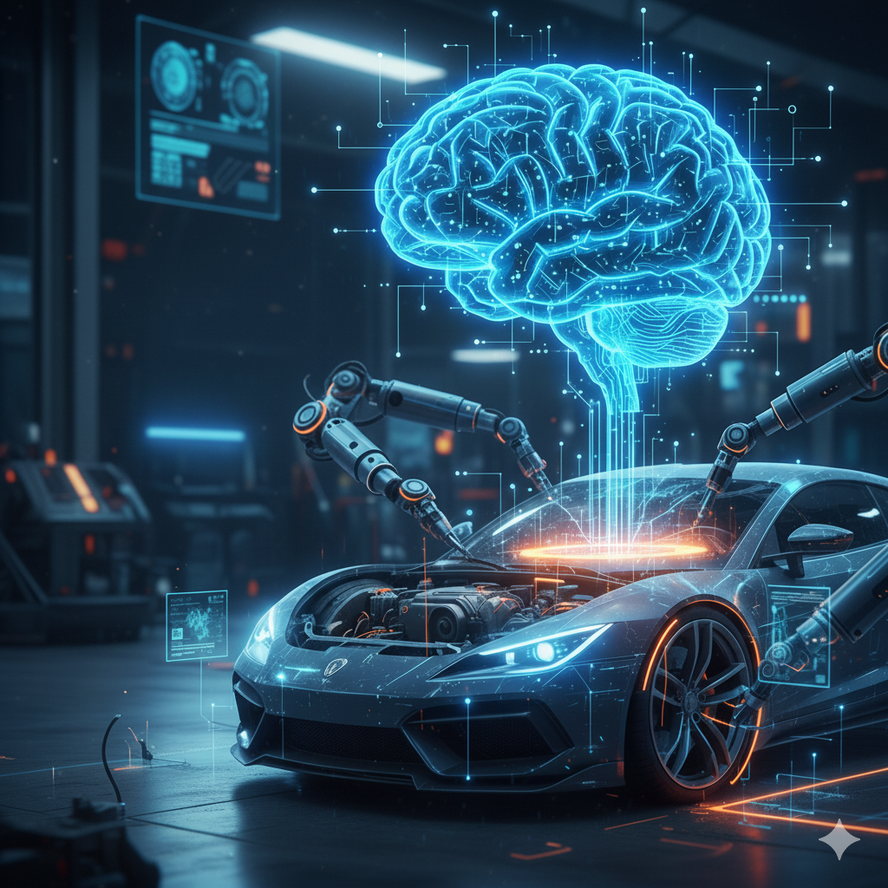
AI-Powered Car Repair Assistant
Advisor: Dr. Muhammad Aminul Islam
Team: Ashok Kumar Jarugubilli
Bharath Chandra Reddy Ukanti
Deshik Sastry Yarlagadda
Yeswanth Labba

Slide 2
Intro & Description of the Task
Problem Statement:
Current repair solutions suffer from inaccurate part identification and static knowledge bases.
Users face poor experiences with limited agentic capabilities (no reasoning/memory).
The Task:
Develop an intelligent system combining Vision AI, RAG, and AI Agents.
Provide accurate, context-aware automotive repair guidance.
Core Goals:
91% accurate part identification.
Dynamic knowledge retrieval via PDFs.
Conversational interface with memory.

Slide 3
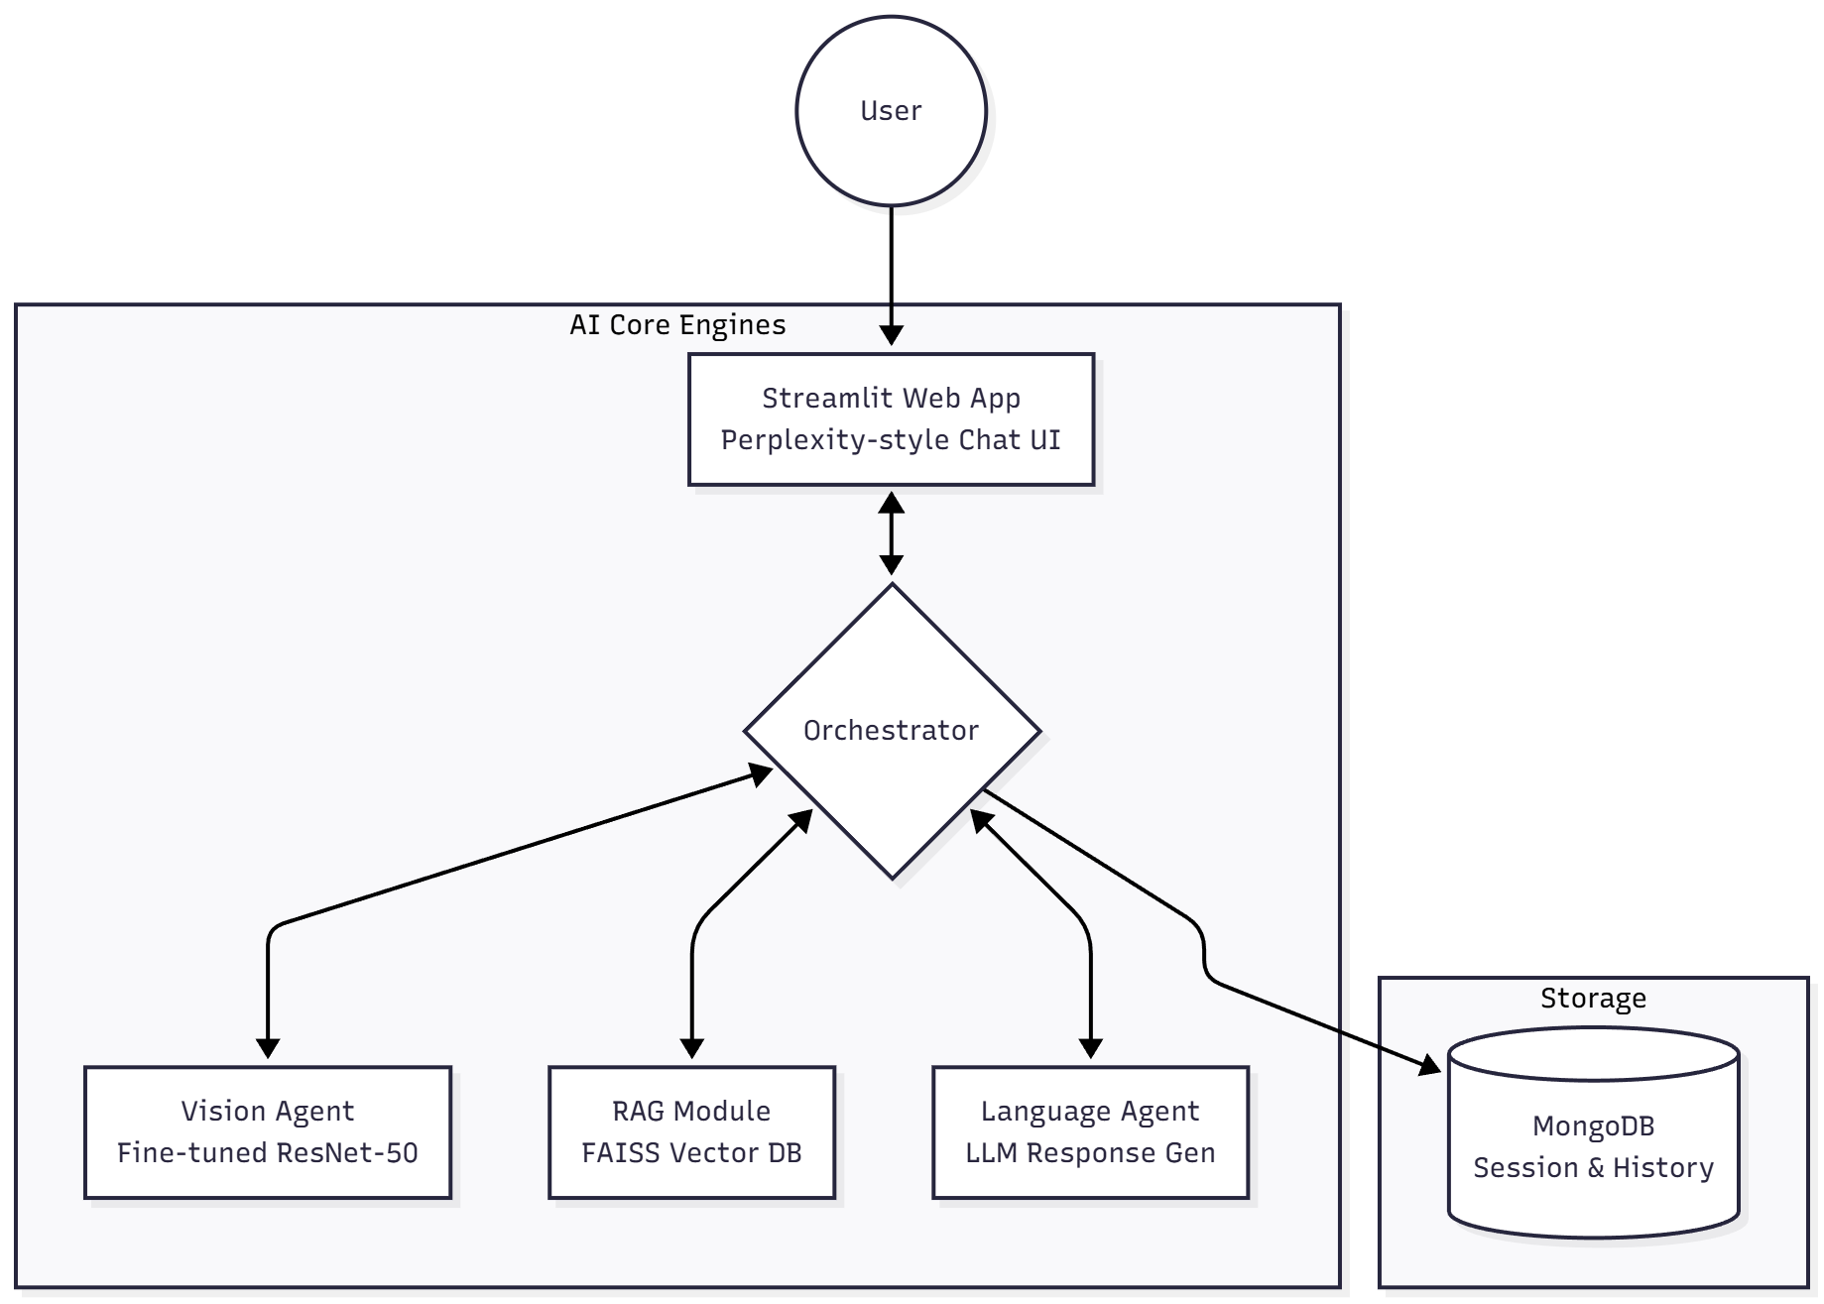
Pipeline / Overview
System Architecture Overview:
Vision Agent: Fine-tuned ResNet-50 for precise car part identification.
RAG Module: Knowledge retrieval from repair manuals.
Language Agent: Conversational AI for Q&A and guidance.
Orchestration Layer: Coordinates the vision, retrieval, and language components.

Slide 4
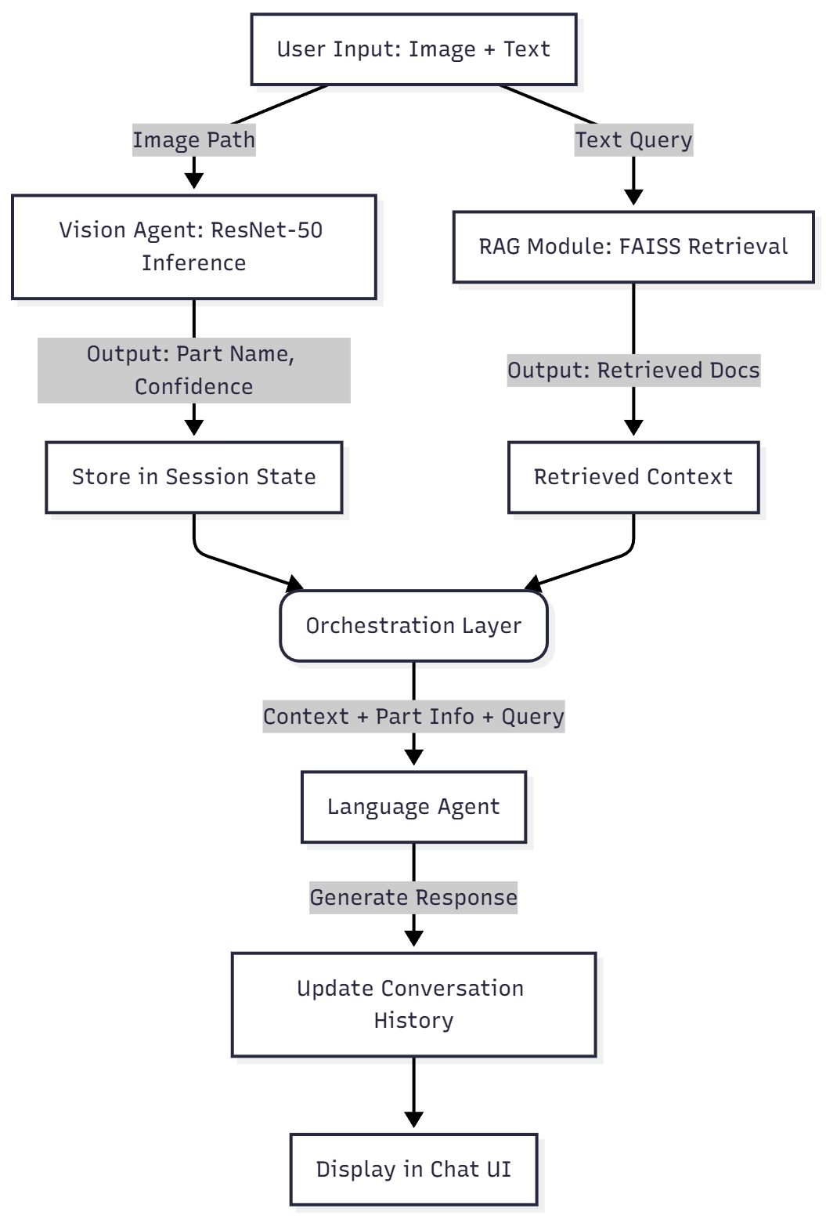
Pipeline / Data Flow
Data Flow:
User Input: Uploads image + asks text question.
Vision Inference: ResNet-50 analyzes image -> outputs Part Name & Confidence.
Retrieval (RAG): Text query is embedded -> FAISS Search -> Top-K Docs retrieved.
Generation: LLM combines User Query + Retrieved Context + Vision Output -> Generates Answer.
Output: Displayed in Chat UI.

Slide 5
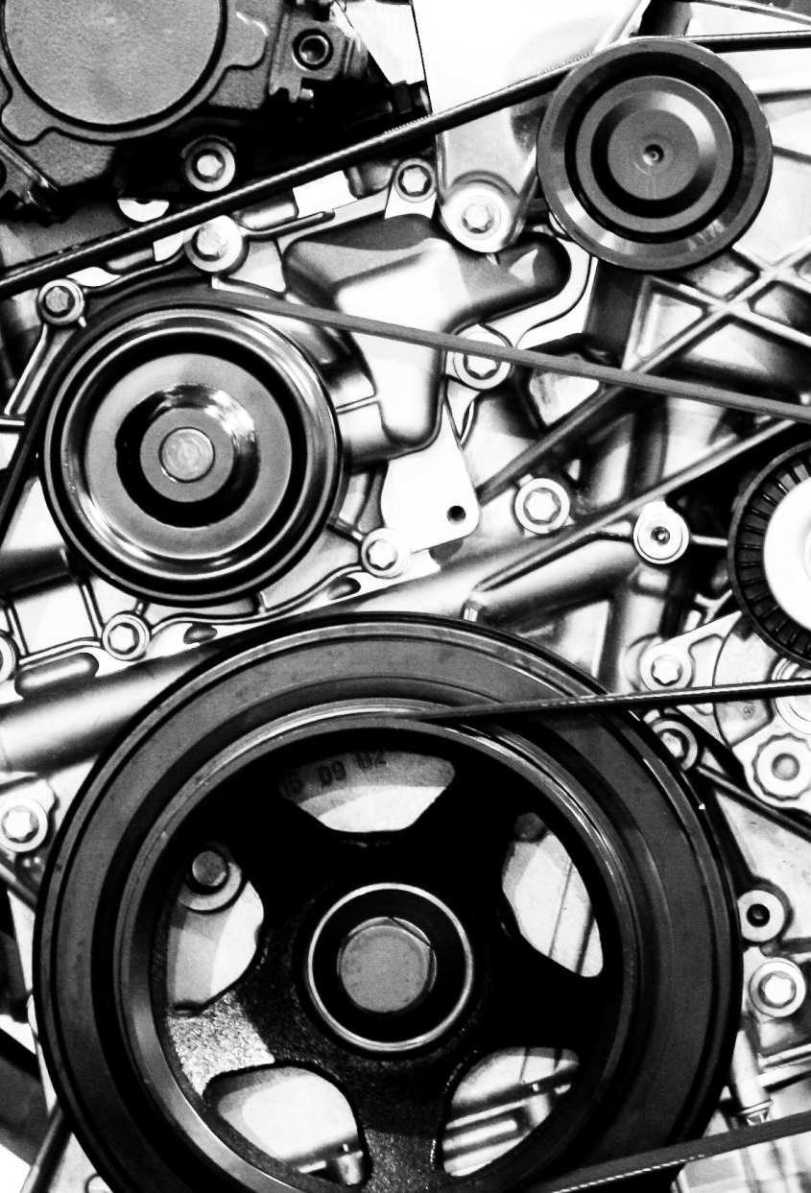
Dataset Overview
Source: Kaggle Car Parts Dataset.
Scale: Total of 9,600 images.
Scope: Covers 40 distinct classes of automotive components.
Examples: Battery, Alternator, Tire, Engine Block, Brake Rotor, etc. .
Purpose:
Used to fine-tune the Vision Agent (ResNet-50).
Solves the problem of accurate part identification where generic models fail.
Key Characteristic: Images vary in lighting, angle, and background, simulating real-world garage conditions.

Slide 6

Data Organization & Splitting
Directory Structure (ImageNet Style):
The data follows a standard "folder-as-label" structure, where the directory name serves as the ground truth label
Structure:
data/car_parts_dataset/train/ (e.g., BATTERY/, TIRE/)
data/car_parts_dataset/valid/
data/car_parts_dataset/test/
Training Split Strategy:
Stratified Split: Used to ensure every car part class is equally represented in both training and validation sets.
Ratio:
Training: 85% of data (approx. 4,070 samples used in final run).
Validation: 15% of data (approx. 718 samples).
Note: A fixed random_state=42 was used for reproducibility.

Slide 7
Data Collection & Examples
Raw Data vs. Annotated Data:
Raw Data: The .jpg or .png images captured from various sources.
Annotation: The annotation is implicit via the directory structure. The system automatically assigns the label based on the parent folder name.
Examples (for the slide visual):
Example 1: Image of a Car Battery Label: 0 (Mapped to "BATTERY").
Example 2: Image of a Tire Label: 1 (Mapped to "TIRE").
Data Loading Class (Code Snippet):
Custom CarPartsDataset class handles the conversion of raw image paths into tensors.
Processing:
Load image and convert to RGB.
Apply HuggingFace ImageProcessor.
Return pixel_values (image tensor) and labels (class ID).

Slide 8
Preprocessing & Augmentation (Vision)
Preprocessing:
Resize: All images resized to 224x224 pixels (ResNet-50 input standard).
Normalization: Applied ImageNet statistics:
Mean (μ) = [0.485, 0.456, 0.406]
Std Dev (σ) = [0.229, 0.224, 0.225]
Augmentation Strategy:
Random rotation (±15°).
Brightness jitter (±0.2).
Horizontal flip.

Slide 9
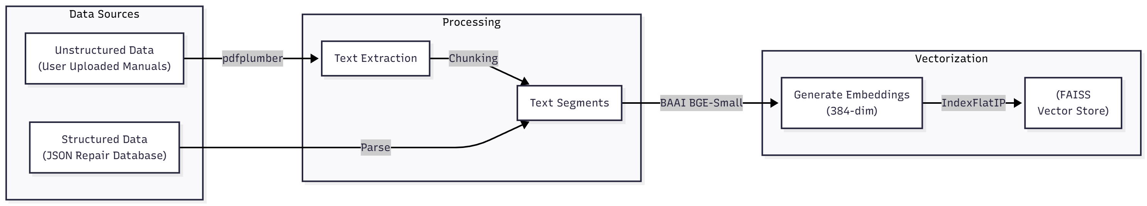
Dataset for RAG
Sources:
General repair knowledge base (JSON format).
User-uploaded Repair Manuals and Technical Documentation (PDFs).
Preprocessing:
Text Extraction: Used pdfplumber to extract text from PDF pages.
Chunking/Embedding: Text converted into 384-dimensional embeddings using BAAI BGE-Small model.

Slide 10
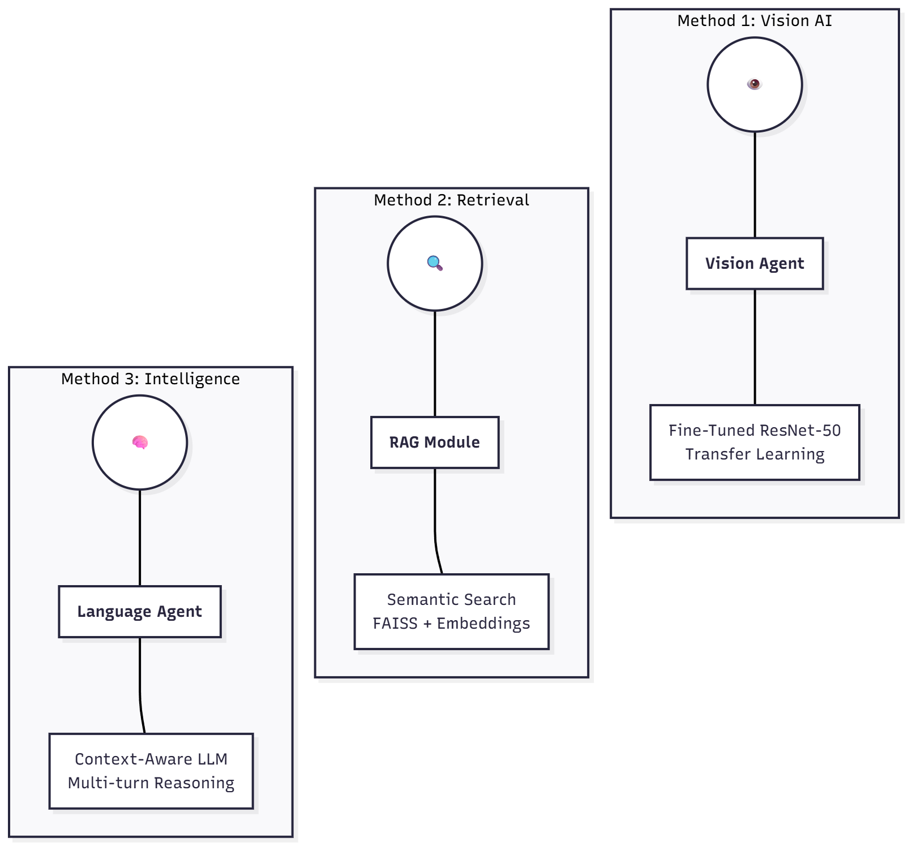
Methods (Overview)
Vision: Transfer Learning using ResNet-50.
RAG: Vector Search using FAISS with BGE-Small embeddings.
Agent: Multi-component orchestration with session state memory.

Slide 11
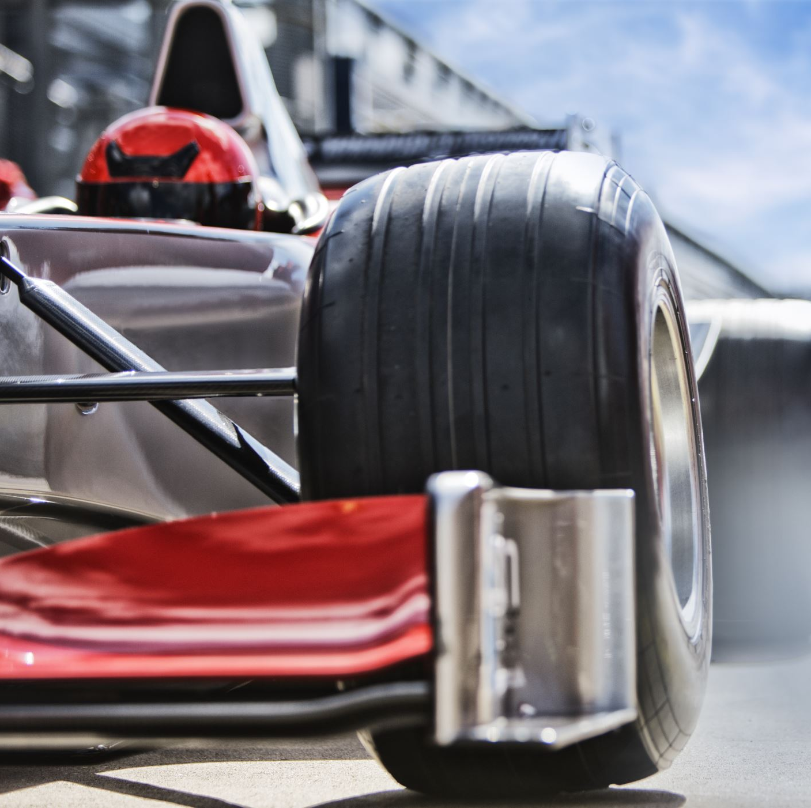
Vision Model (Description & Training)
Model: ResNet-50 (50-layer deep residual network).
Why ResNet-50? Learned generic image features on ImageNet, adapted here for 40 specific car part classes.
Loss Function: L_total = L_CE + λ * L_reg.
Output Layer: Replaced final FC(1000) with FC(40).

Slide 12
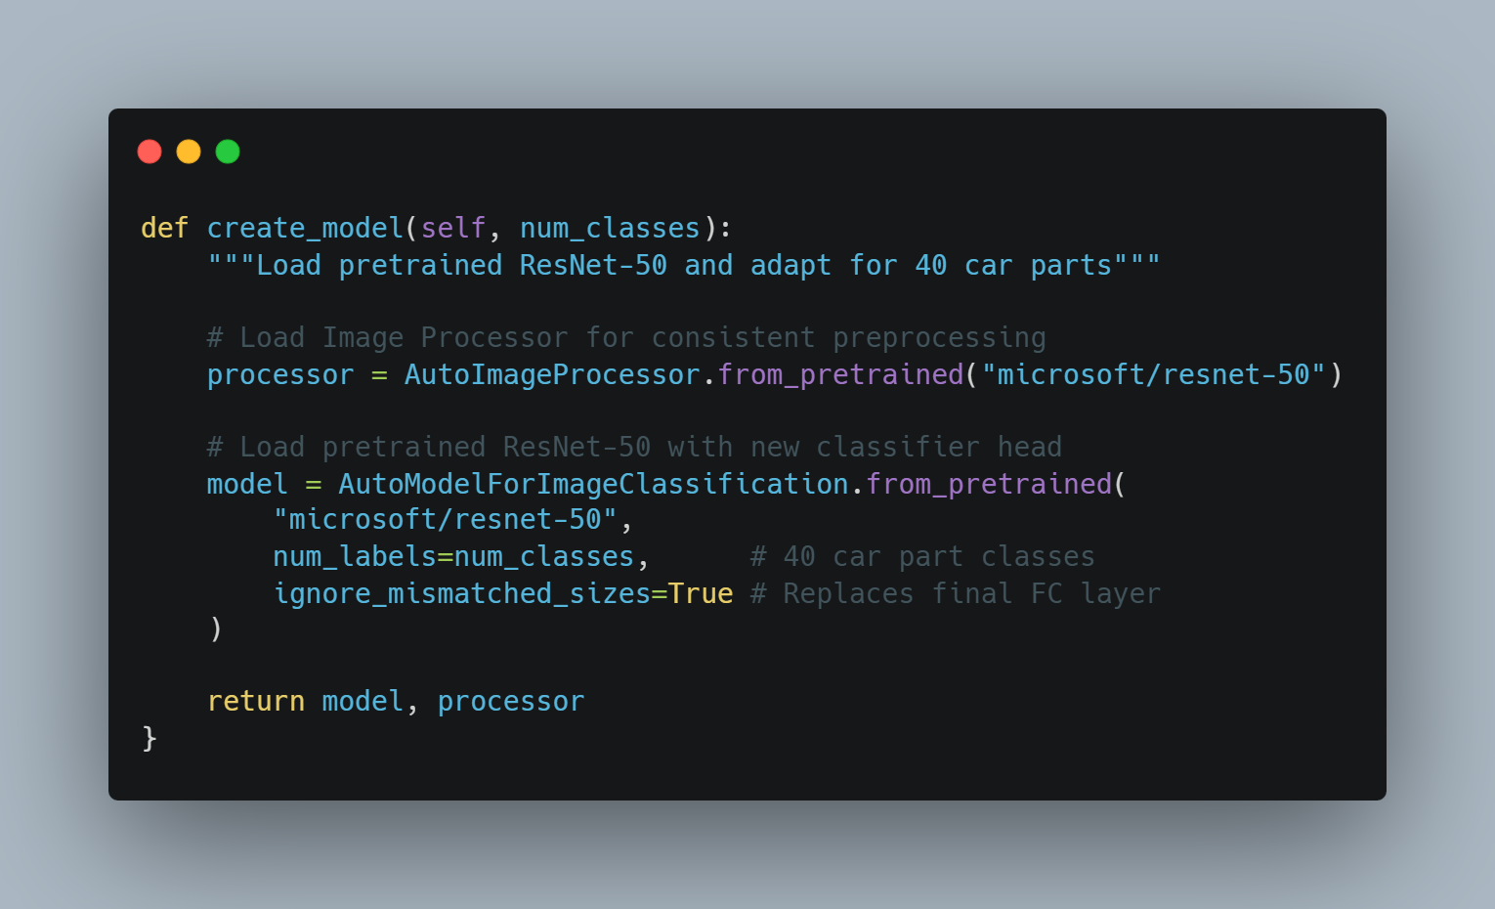
Finetuning Process (Code)
Strategy: Full fine-tuning (all layers trainable), not just frozen backbone.
Code Snippet (Model Creation):
Optimizer: AdamW with weight decay (0.01).

Slide 13
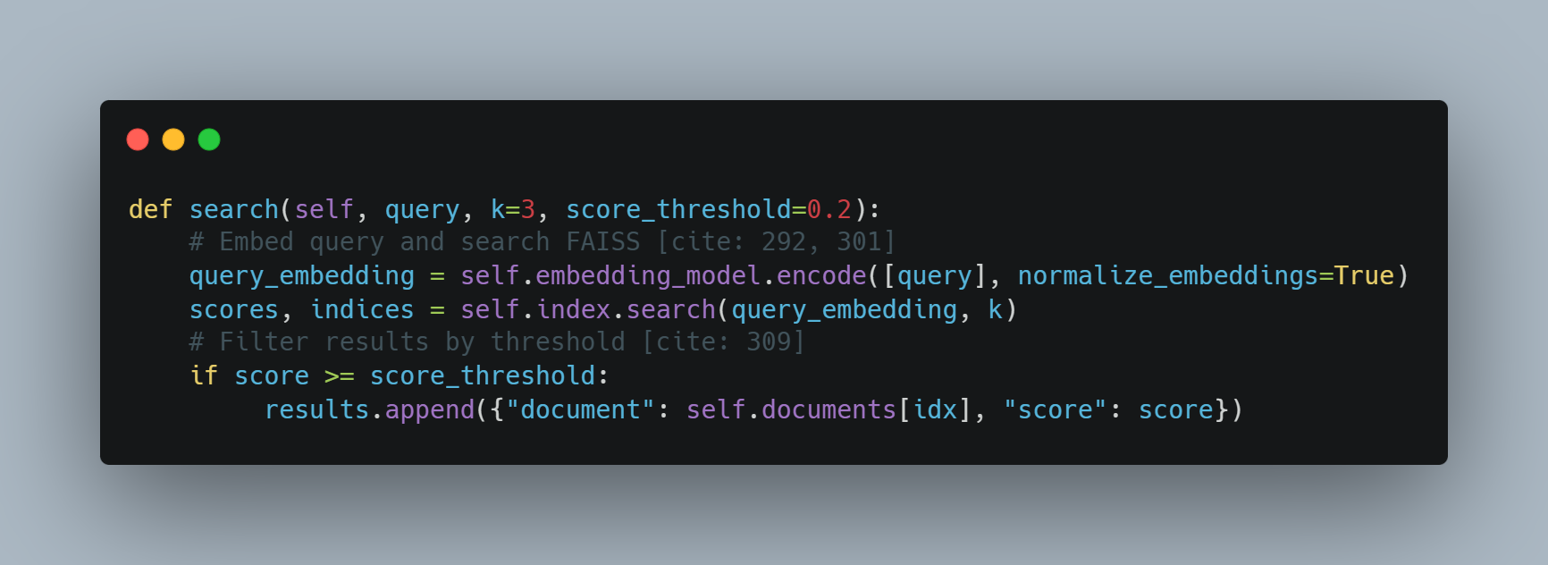
RAG Implementation
Framework:
Embedding Model: BAAI BGE-Small (33M params).
Vector DB: FAISS IndexFlatIP (Inner Product/Cosine Similarity).
Implementation Code:

Slide 14
AI-Agent (Components)
Vision Agent: Autonomous reasoning to analyze images and provide confidence scores.
Language Agent: Context-aware conversational AI that handles multi-turn reasoning.
RAG Agent: Dynamic knowledge learner that conditions the LLM on retrieved docs.
Orchestration Logic:
Combine Vision Output + RAG Context + Conversation History -> Final Response.

Slide 15
Experiments (Setup)
Data Split: Stratified split - 85% Training / 15% Validation.
Hardware:
Training: GPU accelerated.
Inference Speed: ~15-20ms per image (GPU) vs 150-200ms (CPU).
Metric: Evaluated on Eval Loss and Accuracy.

Slide 16
Hyperparameter Tuning
Epochs: 5.
Batch Size: 8 (per device).
Learning Rate: 2e-5 (Lower LR for transfer learning).
Warmup Steps: 100.
Save Strategy: Keep best 2 checkpoints based on eval loss.

Slide 17
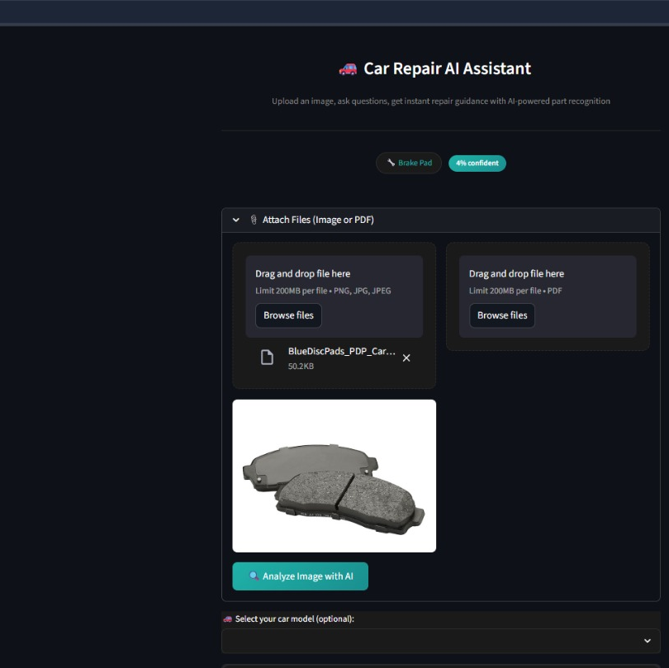
Results (Vision Model)
Performance Metrics:
Overall Accuracy: 91.2% (on 40-class test set).
Top-3 Accuracy: 97.6%.
Precision/Recall/F1: ~90%.
Sample Prediction:
Input: Image of Battery.
Prediction: "BATTERY" (Confidence: 94.2%) - Correct .
Input: Image of Tire.
Prediction: "TIRE" (Confidence: 89.7%) - Correct .

Slide 18
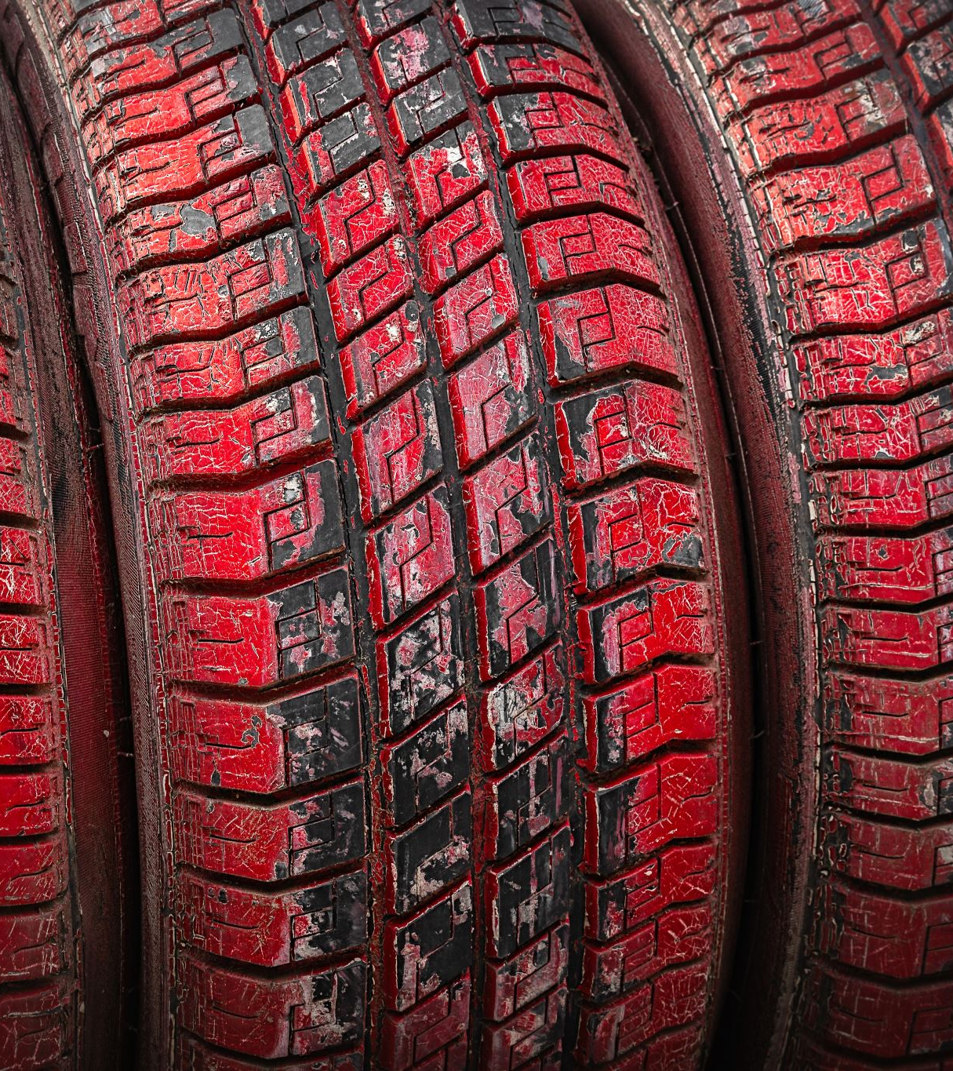
Results (RAG)
Retrieval Metric: Mean Reciprocal Rank (MRR) of 0.782.
Example Retrieval:
Query: "How do I change a tire?"
Retrieved: "Tire changing procedure" (Relevance Score: 0.82).
Query: "Battery replacement steps"
Retrieved: "Battery replacement guide" (Relevance Score: 0.79).

Slide 19
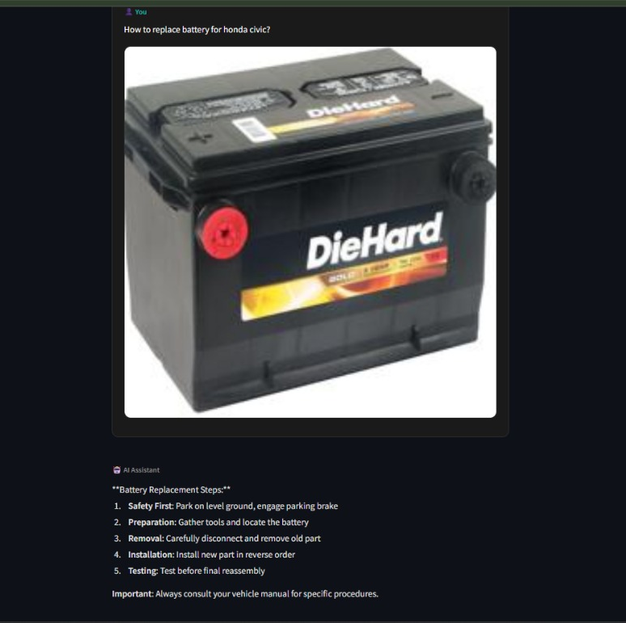
AI Agent Demo
Feature 1: Part Identification:
System displays "BATTERY" with "High Confidence" badge and alternative predictions .
Feature 2: Multi-turn Conversation:
User: "How do I replace this?"
Agent: Provides 5-step procedure with safety warnings .
User: "What about corroded terminals?"
Agent: Context-aware follow-up suggesting baking soda solution.
Feature 3: Custom PDF RAG:
User uploads "Honda Civic Manual.pdf" -> System indexes 125 pages -> Answers specific torque spec questions .

Slide 20
Conclusion
Key Achievements:
Achieved 91.2% accuracy in car part detection.
Implemented Semantic Retrieval to reduce hallucinations.
Created a Production-ready UI with Perplexity-style interaction.
Future Improvements:
Multi-modal Fusion: Combine vision and language embeddings.
Video Processing: Analyze repair videos for step-by-step extraction.
Real-time Collaboration: Enable sharing sessions with mechanics.

